Slide 1
Predicting Pitch Success
By David Marmor

Slide 2
Background
Major League Baseball teams and players have access to more data then ever before.
Pitchers and teams use the data to try and improve pitch characteristics to achieve more success.
With homeruns higher then ever in recent years pitchers that can generate swings and misses (whiffs) are very valuable

Slide 3
Problem Statement
Can we predict whiffs from play by play pitch data? What pitch features are most important to predicting whiffs? Do the important features vary by pitch type.
If we are able to predict whiffs the model could be useful to pitchers and coaches looking to increase their whiffs by varying the characteristics of their pitches.

Slide 4
Data
The data was gathered from baseballsavant.com
Contains data on ever pitch thrown from 2017-2021
Features used in modeling include various measures of speed, spin rate, acceleration, location, and movement

Slide 5
Target variable
The goal of modeling is to predict whiffs.
The target variable is binary and takes a value of 0 if a pitch was swung on and hit and a value of 1 if it was swung on and missed.
Pitches that were not swung at are not included in the model.
Unbalanced classes will be addressed in modeling phase.

Slide 6
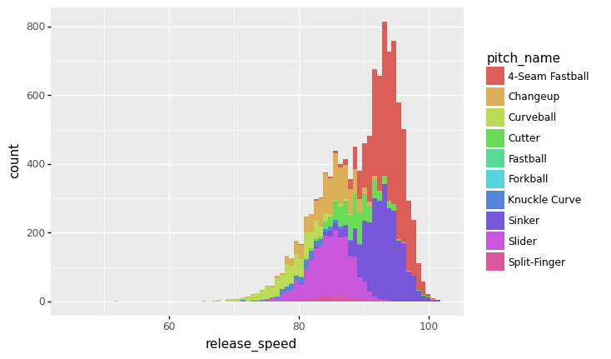
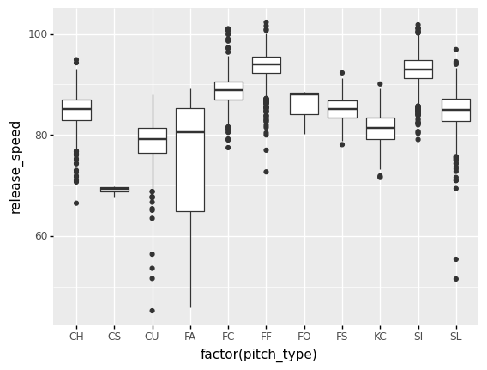
EDA

Slide 7
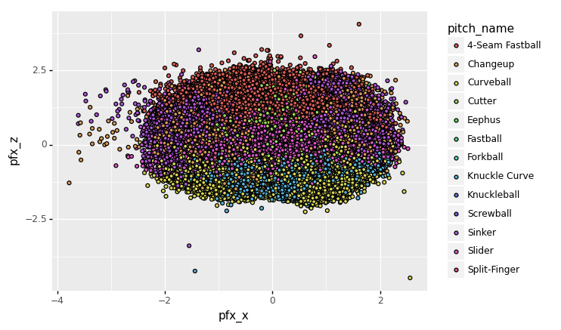
EDA

Slide 8
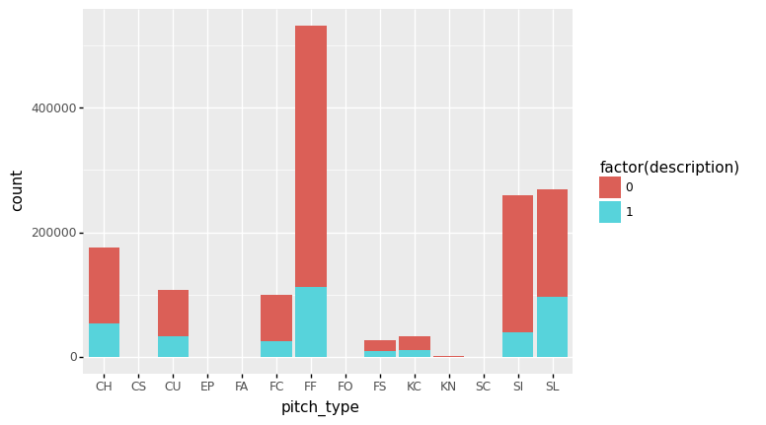
EDA

Slide 9
Modeling
Tried random forests, neural networks, gradient boosting, and logistic regression
Oversampled the smaller class so the baseline was 50% accuracy.
Accuracy is the target metric
Created models of all 9 pitches thrown at least 2,000 times in the data
Random forests models were the best for all 9 pitches

Slide 10
Model comparison (test accuracy)
Pitch | Random Forests | Neural Network | Gradient Boosting | Logistic Regression
Fastball | 0.92 | 0.63 | 0.62 | 0.62
Sinker | 0.96 | 0.65 | 0.63 | 0.60
Slider | 0.82 | 0.71 | 0.70 | 0.69
Changeup | 0.83 | 0.64 | 0.62 | 0.63
Curveball | 0.85 | 0.72 | 0.71 | 0.71
Cutter | 0.89 | 0.67 | 0.65 | 0.63
Knuckle Curve | 0.84 | 0.74 | 0.74 | 0.73
Splitter | 0.79 | 0.69 | 0.67 | 0.68
Knuckleball | 0.91 | 0.71 | 0.88 | 0.81

Slide 11
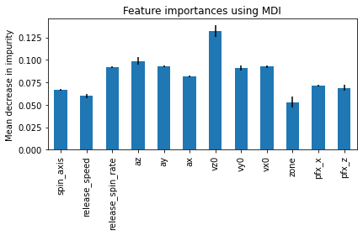
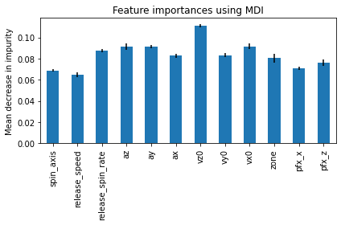
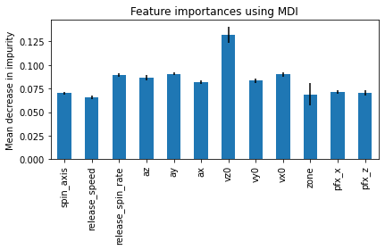
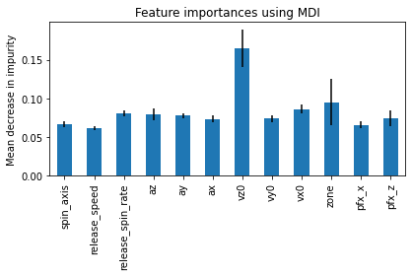
Feature Importance (fastball, sinker, change, splitter)

Slide 12
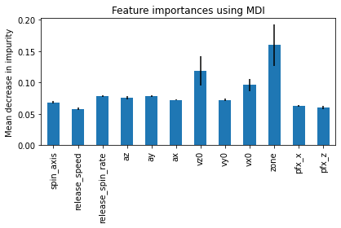
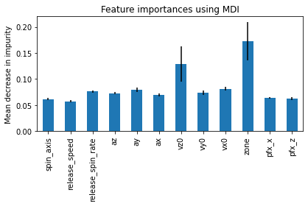
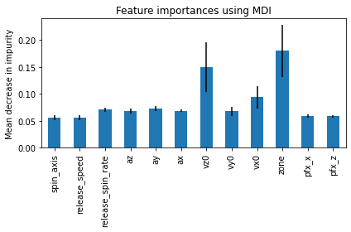
Feature Importance (slider, curve, knuckle curve)

Slide 13
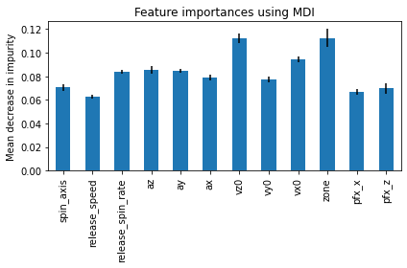
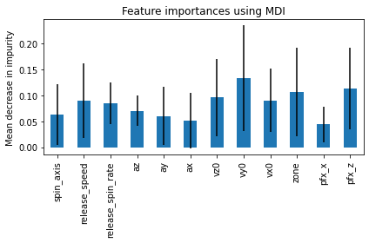
Feature Importance (cutter, knuckleball)

Slide 14
Streamlit Demo
There a streamlit app for each pitch
The streamlit models are simplified so users only have to input the most important features
I will demo the fastball app

Slide 15
Conclusions
It is possible to predict whiffs from pitch data for a variety of pitches. Random Forests models are the best way to do so.
Different pitches have different variable importance however in general speed or location are the most important factors.
Pitchers can use the models to work on their pitch development.

Slide 16
Future Work
Including even more factors in model
Considering soft contact as a success as well as whiffs
Further optimization of model

Slide 17
Thank You
Any questions?

